Slide 1
Managing Software

Slide 2
RPM (Red Hat Package Manager) is a default open source and most popular package management utility for Red Hat based systems like (RHEL, CentOS and Fedora).
The tool allows system administrators and users to install, update, uninstall, query, verify and manage system software packages in Unix/Linux operating systems.
The RPM formerly known as .rpm file, that includes compiled software programs and libraries needed by the packages.
This utility only works with packages that built on .rpm format.

Slide 3
Some Facts about RPM Package
RPM keeps the information of all the installed packages under /var/lib/rpm database.
RPM deals with .rpm files, which contains the actual information about the packages such as: what it is, from where it comes, dependencies info, version info etc.

Slide 4
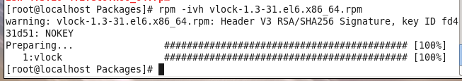
The convention for naming RPM packages is: packagename-a.b.c-x.arch.rpm.
Each part of the package name has a meaning:
Package Name – the name of the package (packagename) Version Number – package’s version number (a.b.c) Build Number – software release number (x) Architecture – the architecture for which the package was built (arch)

Slide 5
Understanding Meta Package Handlers
Even though RPM is a great step forward in managing software, there is still one in convenience-software dependency.
The solution for dependency is the Meta Package Handler.
Meta Package Handler,which in Red Hat is known as yum (Yellowdog Update Manager), works with repositories.
In the repositories, all software packages of your distribution are typically available.
yum install somepackage

Slide 6
A Linux repository is a storage location from which your system retrieves and installs OS updates and applications. Each repository is a collection of software hosted on a remote server and intended to be used for installing and updating software packages on Linux systems.

Slide 7
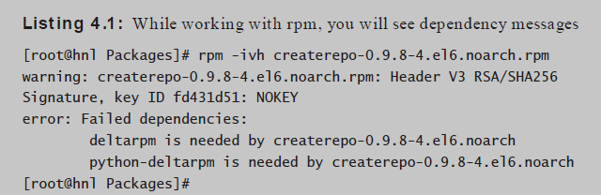

Slide 8
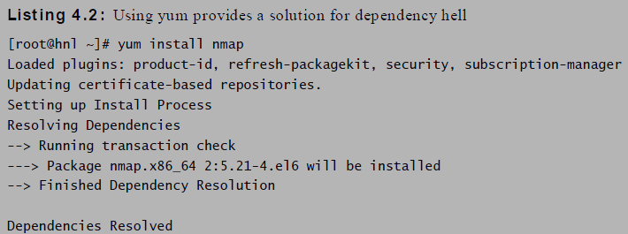

Slide 9
Creating Your Own Repositories
Red Hat server installed that doesn’t have access to the official RHN repositories, you’ll need to set up your own repositories
1. Use mkdir /repo to create a directory that you can use as a repository in the root of your server’s fi le system.
2. Insert the Red Hat installation DVD in the optical drive of your server. Assuming that you run the server in graphical mode, the DVD will be mounted automatically.
3. Use the cd /media/RHEL[Tab] command to go into the mounted DVD. Next use cd Packages, which brings you to the directory where all RPMs are by default.
Now use cp * /repo to copy all of them to the /repo directory you just created.

Slide 10
Now use cd /repo to go to the /repo directory.
From this directory, type rpm –ivh createrepo[Tab].
This doesn’t work, and it gives you a “ Failed dependencies” error.
To install createrepo, you first need to install the deltarpm and python-deltarpm packages.
Use rpm -ivh deltarpm[Tab] python-deltarpm[Tab] to install both of them.
Next, use rpm -ivh createrepo[Tab] again to install the create repo package.
Once the create repo package has been installed, use createrepo /repo, which creates the metadata that allows you to use the /repo directory as a repository

Slide 11
Managing Repositories
To use your newly created repository, you’ll have to tell your server where it can find it.
need to create a repository file in the directory /etc/yum.repos.d.
To see the content of the rhel-source.repo file that is created by default.
[root@hnl ~]# cat /etc/yum.repos.d/rhel-source.repo

Slide 12
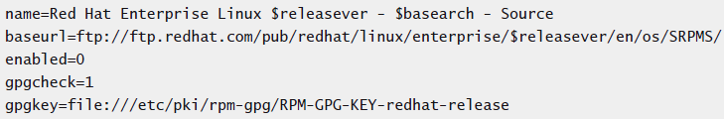

Slide 13
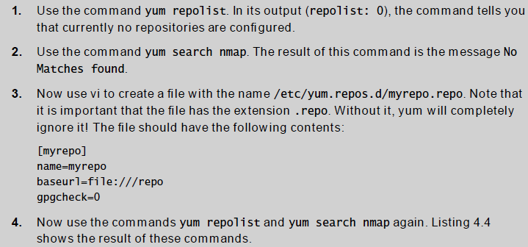

Slide 14
RHN and Satellite
You need a key for the server that you want to connect to.
You need direct access from that server to the Internet
To register a server with RHN, you can use the rhn_register tool
To connect your server to RHN, enter your login credentials
Specify whether you want to connect to RHN or to a Satellite server
After a successful registration, you can start installing updates and patches from RHN

Slide 15
Installing Software with Yum
After configuring the repositories, you can install, query, update, and remove software with the meta package handler yum.
Searching Packages with Yum
yum search nmap
yum search all
If you are looking for the name of a specific file, use
yum provides */zcat.
searches in yum for the package that contains the
file zcat

Slide 16
Installing and Updating Packages
yum install nmap - to install the tool.
Use yum install -y to proceed immediately, without any additional confirmation.
yum update -to update package
Removing Packages
yum remove nmap
If the package you want to remove has many dependencies, by default yum will remove these dependencies

Slide 17
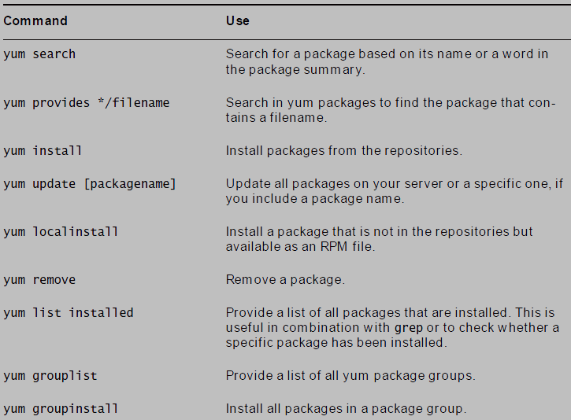
Common yum commands

Slide 18
Querying Software
rpm -q options

Slide 19
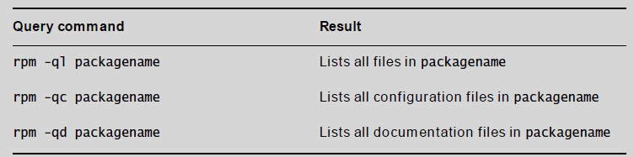

Slide 20
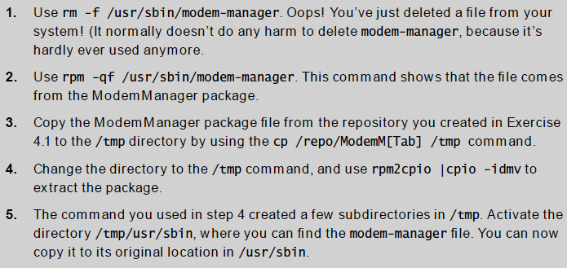
Extracting Files from RPM Packages

